Slide 1
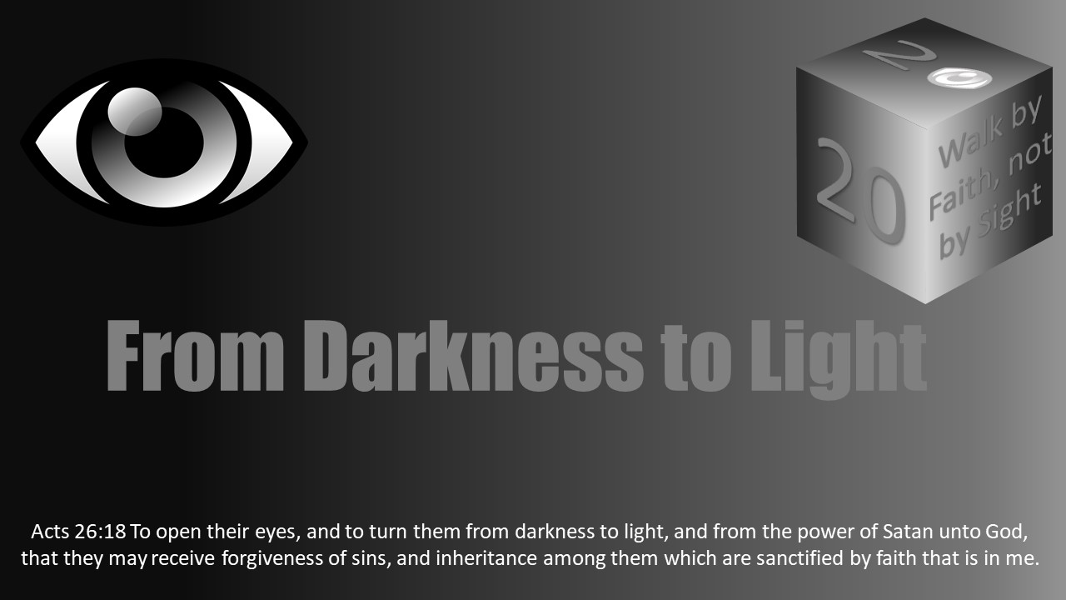


Slide 2
Darkness Lesson 12 The Devil’s Dark Distortions Divorce

Slide 3

Introduction
This darkness is a direct result of Satan’s influence on humanity. He has many tools to blind you from the truth. They range from distorted truths to blatant lies.
My perspectives come from personal events and experiences that required me to diligently seek God’s instruction.
Please study God’s word and find wise counsel to determine what is pleasing to Him with respect to your matters of divorce.

Slide 4
Introduction
“Surely I am more stupid than any man, and do not have the understanding of a man. I neither learned wisdom nor have knowledge of the Holy One. Who has ascended into heaven, or descended? Who has gathered the wind in His fists? Who has bound the waters in a garment? Who has established all the ends of the earth? What is His name, and what is His Son’s name, if you know? Every word of God is pure; He is a shield to those who put their trust in Him. Do not add to His words, lest He rebuke you, and you be found a liar.” (Agur in Proverbs 30:2-6)
Yes, we need God’s protection from Satan’s subtle attempts to distort the pure teachings and commandments of Jesus Christ.

Slide 5
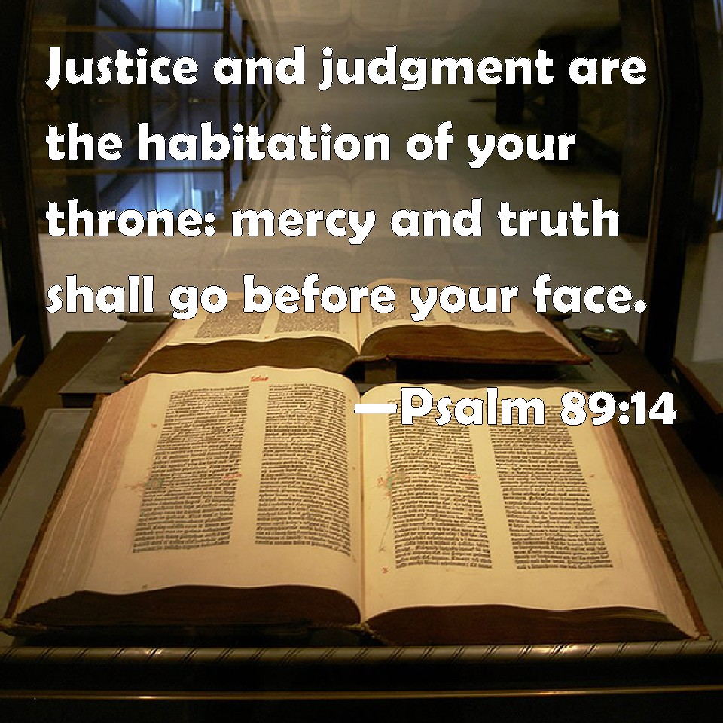
Introduction
This has a personal history for the author that is quite impactive. How did it change your thinking?
Mercy and Truth go before Your Face. - Psalm 89:14

Slide 6

The Darkness of Divorce
Let's start from the beginning just as Jesus has taught us to do.
In the beginning, Adam had the perfect world and relationships to enjoy.
The Garden of Eden was his home.
Most importantly, he had intimate fellowship with God.
Adam walked and talked with God in the garden.
How blessed he was! God provided everything Adam needed.
Above all earthly blessings, he was soon richly blessed with a good woman, a wife, and suitable companion – Eve.

Slide 7
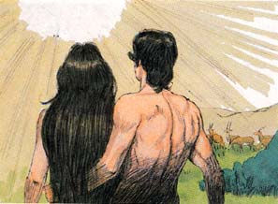
The Darkness of Divorce
Eve was much more than a physical helpmate. She was united with Adam spiritually in holy matrimony designed by God. The two became one flesh and shared fellowship with God in their first home, the Garden of Eden. The perfect marriage!
In addition, God taught Adam and Eve. He provided instructions for them to respect and obey from the purity of their hearts.

Slide 8
The Darkness of Divorce
They were totally dependent upon Him for their everyday existence. They were loved and protected in every imaginable way by our Father, by His hand, His guidance, and His will.
When they disregarded their love for Him in a moment of temptation, deception, and disobedience, then an hour of darkness like none other filled their home.
Treachery entered the garden directed toward God and His word (Gen 3; Mal 2).
The origin? Satan. He opposes God and His word, (Rev 12). Let us not be deceived and forget what God has revealed to us in His word.

Slide 9
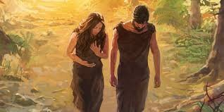
The Darkness of Divorce
Yes, Adam and Eve disobeyed when they neglected God’s word, their eyes were opened, and they discovered the knowledge of good and evil.
Darkness filled the garden and destroyed their perfect new home with God. Pain and suffering followed indeed.
Even more so, they experienced separation from God in their new-found nakedness. They lost God’s protection from pain and suffering. Thus begins the darkest hour, separation from God.
We must also see darkness today in ungodly divorces! Do we acknowledge the separation from God that results from hard hearts and disobedience? God is no longer part of a marriage today when we disobey Him, divorce our spouse, and break our marital vows for any minor reason.
It is an act of violence when a divorce occurs outside of the teachings of Jesus. Violence towards your spouse and God is playing out.

Slide 10

The Darkness of Divorce
When a man has a hard heart toward the very gift God gave him— a companion, a helpmate, a "good thing," a wife—, then his thankfulness to God for her is also hindered.
We do not thank God because we do not take the time to understand our spouse, right?
“Husbands, likewise, dwell with them with understanding, giving honor to the wife, as to the weaker vessel, and as being heirs together of the grace of life, that your prayers may not be hindered” (1 Peter 3:7).
The same is true for both husband and wife.

Slide 11

The Darkness of Divorce
Although Adam and Eve did not experience divorce, broken marriages today end with the same loss of joyful love and fellowship between a man, woman, and God. Especially when divorce is the end result.
Both husband and wife experience great loss.
Our Father, God, has always hated divorce.
Malachi 2:16 is quite clear, “ ‘For the Lord God of Israel says that He hates divorce, for it covers one’s garment with violence,’ says the Lord of hosts. ‘Therefore take heed to your spirit, that you do not deal treacherously.’ ”

Slide 12

The Darkness of Divorce
Do we remember this? Does our society know and remember this? We not only hurt our spouse when we divorce, but we also hurt God. God said, “…let not man separate” in Genesis 3.
Divorce is treachery. We are losing the opportunity with our spouse to jointly raise godly offspring.
Malachi, the prophet, warns us: Yet you say, “For what reason?” Because the Lord has been a witness between you and the wife of your youth, with whom you have dealt treacherously; yet she is your companion and your wife by covenant. But did He not make them one, having a remnant of the Spirit? And why one? He seeks godly offspring. Therefore take heed to your spirit, and let none deal treacherously with the wife of his youth (Mal 2:14-15).

Slide 13

The Darkness of Divorce
In Deuteronomy 24, men are putting their wives away and out of the house.
Why? Because they forgot what God said in the beginning?
Because they decided it was “ok” to put their wives away for any cause?
Because they had hard hearts toward God and their wives? Yes, they were sinning against God first and their wives too.
Deuteronomy 24:1-4 provides the Old Testament context needed to fully understand Jesus when he rebukes the Pharisees in Matthew 19.

Slide 14
The Darkness of Divorce
Deuteronomy 24:1-4 reads: “When a man takes a wife and marries her, and it happens that she finds no favor in his eyes because he has found some uncleanness in her, and he writes her a certificate of divorce, puts it in her hand, and sends her out of his house, when she has departed from his house, and goes and becomes another man’s wife, if the latter husband detests her and writes her a certificate of divorce, puts it in her hand, and sends her out of his house, or if the latter husband dies who took her as his wife, then her former husband who divorced her must not take her back to be his wife after she has been defiled; for that is an abomination before the Lord, and you shall not bring sin on the land which the Lord your God is giving you as an inheritance.”

Slide 15

The Darkness of Divorce
Did God, through Moses, intend to allow all divorces under the sun to be permitted?
Was He giving men a “season pass” for divorce?
No! He was giving mercy to the women who were mistreated by the hard-hearted men.
This is not the norm God wants.
People today, just like the Pharisees in Matthew 19, have it all backward too.
They want to freely divorce in many cases for any arbitrary reason.
This requires men to distort or ignore revelation, God’s design for marriage.

Slide 16

The Darkness of Divorce
Does God distort His own words as men do?
He is not double-minded. He is always the same.
Hebrews 13:8-9 teaches, “Jesus Christ is the same yesterday, today, and forever. Do not be carried about with various and strange doctrines. For it is good that the heart be established by grace.”
There is no doubt, Jesus rebuked the Pharisees in Mathew 19 sharply. He also knew their thoughts were exactly like the men of Deuteronomy 24, with hard hearts.
Jesus did this by recalling His Father’s words and authority from the beginning, from the Garden of Eden. Jesus is surely not happy when He answers.
Possibly, He is in agony while He speaks. Let the words of Jesus remind us today too.

Slide 17
The Darkness of Divorce
Matthew 19:3-10 sets the record straight:
The Pharisees also came to Him, testing Him, and saying to Him, “ ‘Is it lawful for a man to divorce his wife for just any reason?’ And He answered and said to them, ‘Have you not read that He who made them at the beginning ‘made them male and female,’ and said, ‘For this reason a man shall leave his father and mother and be joined to his wife, and the two shall become one flesh’? So then, they are no longer two but one flesh. Therefore what God has joined together, let not man separate.’ They said to Him, ‘Why then did Moses command to give a certificate of divorce, and to put her away?’ He said to them, ‘Moses, because of the hardness of your hearts permitted you to divorce your wives, but from the beginning it was not so. And I say to you, whoever divorces his wife, except for sexual immorality, and marries another, commits adultery; and whoever marries her who is divorced commits adultery.’ His disciples said to Him, ‘If such is the case of the man with his wife, it is better not to marry.’ ”

Slide 18
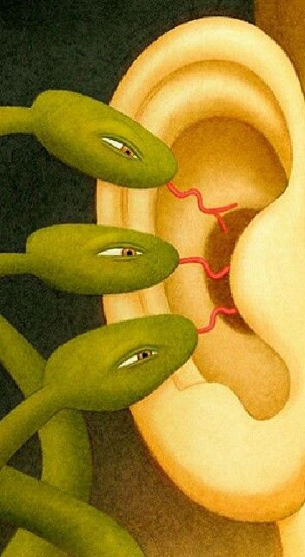
The Darkness of Divorce
Jesus is standing before the Pharisees giving them direct revelation.
His message was inclusive for all people, of all ages, including us today.
The Pharisees’ distorted thinking came from hard hearts and Satan’s influence.

Slide 19
The Darkness of Divorce
We must know the entirety of God’s word and keep it in proper context, always.
Psalm 119:116 is a reminder from King David: “The entirety of Your word is truth, And every one of Your righteous judgments endures forever.”
When we properly consider God’s words during the creation of marriage in Genesis 3, along with the thoughts and actions of men in Deuteronomy 24, and consider Jesus’ response to the Pharisees in Matthew 19 is a rebuke in light of the entirety of God’s word.
We understand who had the hard hearts. We understand what God said. We understand what Jesus said. We know who or what caused women to be defiled after the second marriage.
We can clearly see, God did not allow the promise land to be polluted with an abomination. Will God allow heaven to be polluted with uncleanness?

Slide 20

The Darkness of Divorce
Is our heart hard today?
Have we forgotten what Jesus said to the Pharisees? Have we forgotten what Jesus said in Matthew 19?
Are we out of context and neglecting portions or the “entirety” of God’s word?

Slide 21
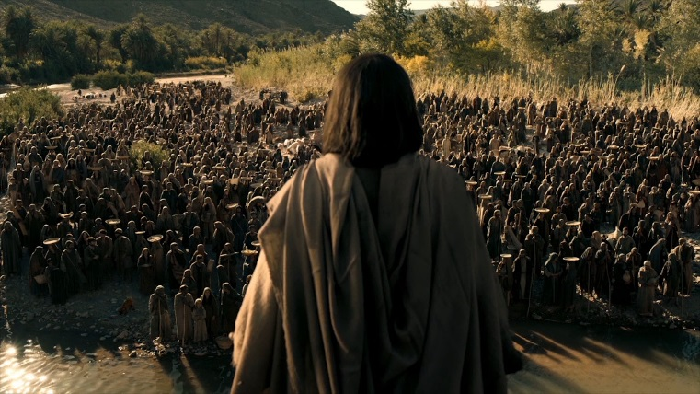
The Darkness of Divorce
What about the Sermon on the Mount in Matthew 5?
Has Satan distorted that too in men’s hearts?
Has it been watered down, sugar coated, and now also forgotten in the courts of the land today?
Matthew 5:31-32 makes clear, “Furthermore it has been said, ‘Whoever divorces his wife, let him give her a certificate of divorce.’ But I say to you that whoever divorces his wife for any reason except sexual immorality causes her to commit adultery; and whoever marries a woman who is divorced commits adultery.”

Slide 22

The Darkness of Divorce
If you have forgotten, let the word of God discern and remove Satan’s distortions in your heart.
Replace carnal thinking with God’s spiritual perspective on life. This will clear your vision and heart.
Hebrews 4:12 ensures us, “For the word of God is living and powerful, and sharper than any two-edged sword, piercing even to the division of soul and spirit, and of joints and marrow, and is a discerner of the thoughts and intents of the heart.”

Slide 23

The Darkness of Divorce
In Mathew 19, the Pharisees were thinking just like the men of Deuteronomy 24. Both had hard hearts and a distorted understanding. They were changing the word of God and turning it upside down. Are we doing the same today within the courts of man? Do they often reject God’s word?
In the case of my divorce, an attorney warned I would never be permitted to use religious beliefs in their secular courts. My response was in the form of a simple question: “…Then how did the courts accept my marriage with the Bible opened and a preacher quoting from the word of God during the marriage?”

Slide 24
The Darkness of Divorce
Humanity’s thinking is becoming shameful, inconsistent, and distorted.
Is history repeating itself?
Who is man to forbid God’s word in our courtrooms today?
Even though the paralegal agreed with God’s word and expressed genuine godly sorrow to me while preparing for my divorce case, I was adamantly warned again the courts would not permit any religious beliefs, whatsoever!
The divorce would be granted for “any reason” and there was no way to stop it. I sadly learned that day, some of man’s courts have chosen to distort or disregard, entirely, the teachings of Jesus Christ.

Slide 25

The Darkness of Divorce
Let us remember God’s holy court and honor His eternal word.
“For a day in Your courts is better than a thousand. I would rather be a doorkeeper in the house of my God than dwell in the tents of wickedness” (Ps 84:10).
Zechariah 3:7 instructs: “Thus says the Lord of hosts: ‘If you will walk in My ways, And if you will keep My command, Then you shall also judge My house, And likewise have charge of My courts; I will give you places to walk Among these who stand here.’ ”

Slide 26
The Darkness of Divorce
Although Satan has a short amount of time to distort God’s word, rest assured, God’s word is eternal and unchanging for those who chose to obey!
Mark 13:31 confirms, “Heaven and earth will pass away, but My words will by no means pass away.”

Slide 27
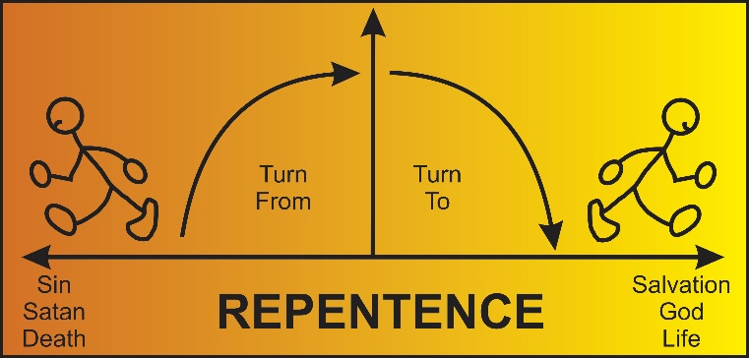
Godly Sorrow
The words of Agur, recorded in Proverbs 30, humbles me to this day…"Surely I am more stupid than any man, And do not have the understanding of a man. I neither learned wisdom nor have knowledge of the Holy One.”
2 Corinthians 7:10. “For godly sorrow produces repentance leading to salvation, not to be regretted; but the sorrow of the world produces death.” When we sin against God, sincere godly sorrow moves us in the right direction. It moves a humble heart to repent and truly please Him once again

Slide 28
Godly Sorrow
Separation from God occurs when an unmerited divorce is practiced.
Fellowship is lost with God and a spouse.
Separation is Satan’s goal and great darkness. The sorrow, heartache, and tears will follow when you realize God is not pleased and your marriage is lost.
I am thankful for the wise men and godly sorrow that brought me to bended knees in prayer.
It was then, and only then, that I could see clearly again.

Slide 29

Worldly Sorrow
Divorce brings about worldly sorrows too.
This sorrow is unavoidable in everyday life. Although it pales in comparison to knowing you displeased God, numerous reminders shadow divorce.
In my experience after divorcing, you may have to overcome loneliness and public shame.
There is also a good chance you will answer endless questions about why you are divorced for those courageous to ask.
If you don’t have children before the divorce, it is tough to realize life with no children or grandchildren.
You’ll even be reminded of your divorced status when completing the martial section of job applications and health forms. The list goes on and on if you dwell on it.
These worldly sorrows should be reminders of the most important sorrow, godly sorrow.

Slide 30

Worldly Sorrow
The right spirit and mind are needed to overcome worldly sorrow.
Remind yourself often of 2 Timothy 1:7, “For God has not given us a spirit of fear, but of power and of love and of a sound mind.”
While a person full of courage will overcome the darkness of worldly sorrows, the person moved by godly sorrow will overcome the sin and repent before God (Ps 51).
We must strive to overcome both.

Slide 31
Worldly Sorrow
All dark moments can be overcome by faith in God’s word and a little help from supportive friends who kindly and tactfully practice Galatians 6. These friends are a true blessing!
Galatians 6:1-2 brings loving fellowship and support to the soul lost in darkness. “Brethren, if a man is overtaken in any trespass, you who are spiritual restore such a one in a spirit of gentleness, considering yourself lest you also be tempted. Bear one another’s burdens, and so fulfill the law of Christ.”

Slide 32
Worldly Sorrow
Thinking about good things will also help overcome worldly sorrow.
Do not let Satan distort things and plant a bitter seed in your heart.
He has all sorts of lies to tell us. Cast Satan out with good thoughts and deeds.
Philippians 4:8 wisely guides us, “Finally, brethren, whatever things are true, whatever things are noble, whatever things are just, whatever things are pure, whatever things are lovely, whatever things are of good report, if there is any virtue and if there is anything praiseworthy—meditate on these things.”
There always remains hope and joy if we will, once again, listen to God.

Slide 33
Worldly Sorrow
Satan’s ultimate goal in marriage is to destroy the family by distorting or eliminating God's word from humble hearts.
Satan will tempt us to practice frivolous, ungodly divorce.
Divorce truly hurts God and destroys His fellowship within the family.
The triangle relationship between spouses and God is broken.
The ability to produce godly offspring within a broken relationship is severely challenged.

Slide 34

Worldly Sorrow
Today, the family unit is violently under attack in our country.
Moral decline is quite apparent. Sadly, the courts in our land are listening more and more to the distorted words of men and Satan with respect to divorce, marriage, and remarriage. We must remember and obey God’s commandments.
We must keep our vows as commanded by Paul in 1 Corinthians 7:10-11, “Now to the married I command, yet not I but the Lord: A wife is not to depart from her husband. But even if she does depart, let her remain unmarried or be reconciled to her husband. And a husband is not to divorce his wife.”

Slide 35
Key Lessons Learned
Marriage is Between One Man and One Woman for Life
Jesus abruptly rebuked the Pharisees for implying divorce is quite acceptable for any reason.
“Why then did Moses command to give a certificate of divorce, and to put her away?”
The Pharisees attempted to justify divorce and remarriage in all cases using the worst scenario created by man in Deuteronomy 24.
The mistake Jesus is addressing in Matthew 19. Immediately we can see and feel the pain in His heart.
He reminds them of the hardness of men’s hearts and how they profane our Father’s perfect holy marriage between one man and one woman defined clearly in the Garden of Eden.
Did the Pharisees just forget God's plan and instructions or neglect them? Maybe both? Were they deceived by Satan? Yes. When carnal chaos darkens men's hearts, Jesus and His word restores righteous order.
The same is true in society today. Is this happening among God’s children? Is this happening in the church where you worship? Are we like the Pharisees? If yes, then read again and listen to Jesus in Matthew 19. He is also saying that to us today.

Slide 36
Key Lessons Learned
God Hates Divorce!
Can you think of one case where God is pleased with the end result of divorce? God hates divorce!
He is forgiving, and we can also forgive a spouse that is found “naked” in the garden when they repent. God does permit divorce in the case of adultery, but he still hates divorce.
He teaches us to repent, forgive, and reconcile if possible. Our Father in heaven is loving, merciful, and kind.
Mark 11:12 reminds us to consider, “But if you do not forgive, neither will your Father in heaven forgive your trespasses.”
When we do not love and honor God’s life-giving words full of joy for every tribulation, then we will also be tempted, deceived, and disobey like Adam and Eve.
The darkness of divorce will fill our home until we repent out of godly sorrow.
If we do not remember what God taught us, we will become like the Pharisees allowing or even encouraging divorce for any reason.

Slide 37
Key Lessons Learned
The Darkness of Divorce is Separation from God and your Spouse.
Satan knows you shall surely die once he separates you from God. He deceives you into believing you have a right to be “happy” and to enjoy a life full of sin even if it occurs before God in His garden, His church, or His holy gift of marriage.
Marriage is an intimate gift shared with God between you, your spouse, and Him. (Car example)
Satan distorted what God told Adam and Eve in Genesis. God warned them and warns us today. Satan is more than pleased to accuse you before God. He will distort the life-giving words of God, if you freely choose to allow himA marriage and the church may exercise discipline in a similar manner as God justly did in the Garden with Adam and Eve. In all three instances, someone can be divorced, withdrawn from, or put out. The result? Relationships may be destroyed eternally! We must discipline ourselves. Separation, where there is no repentance or forgiveness of sin, is the darkest moment of divorce. Satan’s end game is to separate you from God resulting in spiritual death if reconciliation does not occur. He often begins by attacking one or both spouses.

Slide 38
Key Lessons Learned
Count the Cost
The darkness of divorce goes well beyond the emotional pain one may experience.
The vows made before God and others are for life. Separating from a spouse creates a vast reaching void. Only God's forgiveness, mercy, and grace can bring light to the darkness of divorce and fill the void.
Before you decide to lawfully divorce a spouse, please honestly consider the far-reaching impact on your family, community, and the nation. Families are the backbone of every nation.
Count the cost.
Erroneous divorces are only one distortion of God’s word Satan uses to accomplish his hidden agendas. Satan has his own version of the truth to entice you. It is called a lie. His lies are sugar-coated distortions of the truth. They are so enticing that you can miss what is right in front of you. They may taste good for the moment, but they are loaded with a deadly poison that can separate you from God today, tomorrow, and eternally.
The greatest darkness of all is reserved for the person who misses heaven. Please count the cost.

Slide 39
Key Lessons Learned
Remember God’s Word
Who is our Father? God or Satan? If we say “God,” we must identify and stop all deception, blame, and malice. Reject Satan’s distortion of God’s word.
A faithful, humble heart will replace sin with truth and kindness taught by our Father. And, the darkness of divorce will be no more.
Separation from God and your spouse will be restored with love and fellowship once again.
Proverbs 3:1-7 instructs the children of Light: “My son, do not forget my law, but let your heart keep my commands; for length of days and long life and peace they will add to you. Let not mercy and truth forsake you; bind them around your neck, write them on the tablet of your heart, and so find favor and high esteem in the sight of God and man. Trust in the Lord with all your heart, and lean not on your own understanding; in all your ways acknowledge Him, and He shall direct your paths. Do not be wise in your own eyes; fear the Lord and depart from evil.”

Slide 40
Key Lessons Learned
If Involved with Divorce, Love God with All Your Heart, Soul, and Mind.
In times of darkness during and after divorce, please reflect on the instruction wise men and women share from God's word.
Pray, meditate, and seek forgiveness when the shadows of divorce haunt and tempt us to yield.
The best advice is to avoid divorce where possible.
It is a commandment. How? Love God with all your heart, soul, and mind (Lk 10:12).
Follow His word, and you will understand how to love Him, His guidance, your enemies, your neighbor, your family, and your spouse.

Slide 41
Key Lessons Learned
Faith in Jesus Christ Brings Victory
We can enjoy fellowship with God and our spouse, today, tomorrow, and eternally.
We can enter heaven using our own free will humbly obeying His word and remaining pure. How? Faith in Jesus Christ brings victory.

Slide 42
Key Lessons Learned
Faith in Jesus Christ brings victory.
Hebrews 12:1-3 teaches us to focus on Jesus. “Therefore we also, since we are surrounded by so great a cloud of witnesses, let us lay aside every weight, and the sin which so easily ensnares us, and let us run with endurance the race that is set before us, looking unto Jesus, the author and finisher of our faith, who for the joy that was set before Him endured the cross, despising the shame, and has sat down at the right hand of the throne of God.”
We must choose wisely and fight each day to “…keep the commandments of God and have the testimony of Jesus Christ.” (Rev 12:17)
In Christ, we can be delivered from darkness as Paul reinforced in Colossians 1:13-14, “He has delivered us from the power of darkness and conveyed us into the kingdom of the Son of His love, in whom we have redemption through His blood, the forgiveness of sins.”
Let us not forget John 14:6: “Jesus said to him, “I am the way, the truth, and the life. No one comes to the Father except through Me.”

Slide 43
Conclusion
The Apostle Paul’s admonition in Romans 12:18 also applies to marriages. “If it is possible, as much as depends on you, live peaceably with all men.”
This includes a spouse even more so! Value them as a sanctified gift above all. Live together in harmony with God and the teachings of Jesus Christ. Understand and communicate in truth and kindness offering prayer often, (Prov 3:3; 1 Pet 3:7).
Please avoid divorce at all costs where possible while confessing your shortcomings to one another before God.
Love God with all your heart mind and soul. Only then, will you see clearly and love your spouse in the same manner.
If you choose wisely to please God, Satan’s distortions will fade away and divorce will no longer be in sight.
Yes! A husband and wife may enjoy victory together through their shared love, purity, and faith in Jesus Christ.

